Slide 1
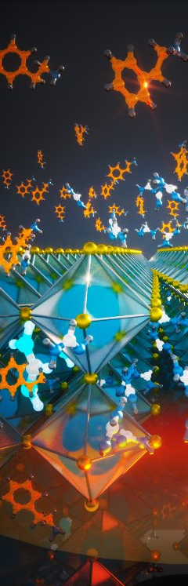

Energy Materials
Laboratories
Andrew Chen
Undergraduate
College of Computing
Stability Setup Update
Friday April 25, 2025

Slide 2
Outline
1.
Motivation/Background
4.
Experiment Setup
2.
Hardware
5.
Experiment Results
3.
Software
6.
Future Works

Slide 3
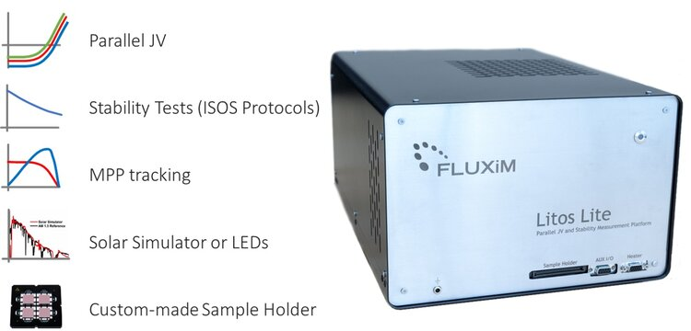
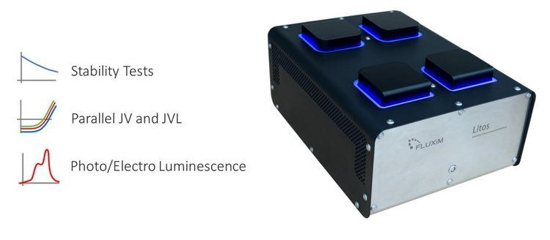
Motivation/Background
Litos and Litos Lite are very expensive
Only 4 devices can be stress tested at a time in the lab
Large scale stability testing is infeasible with commercially available products
Solution: Stability Measurement System (SMS)
Notes:
Chiral Perovskites​
Chirality is induced by adding chiral molecules in A-site​
Crystal orientation plays huge role in chirality of perovskites​
Poor photoluminescence quantum yield at room temperature​
RP Dimensionality​
Competition between 2D/quasi-2D/3D phase crystallization​
Effects bandgap, conductivity, energy funneling​
​
​

Slide 4
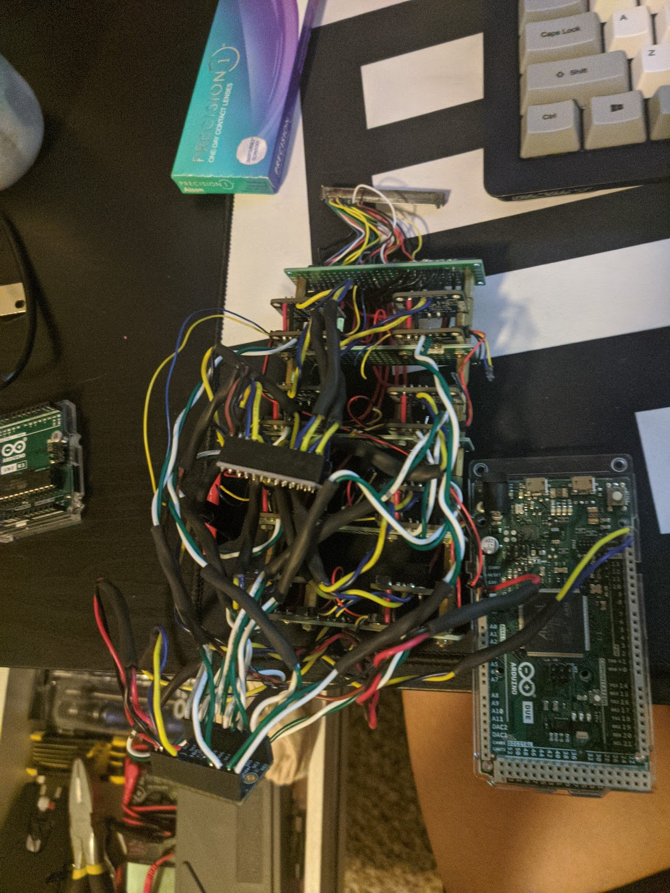
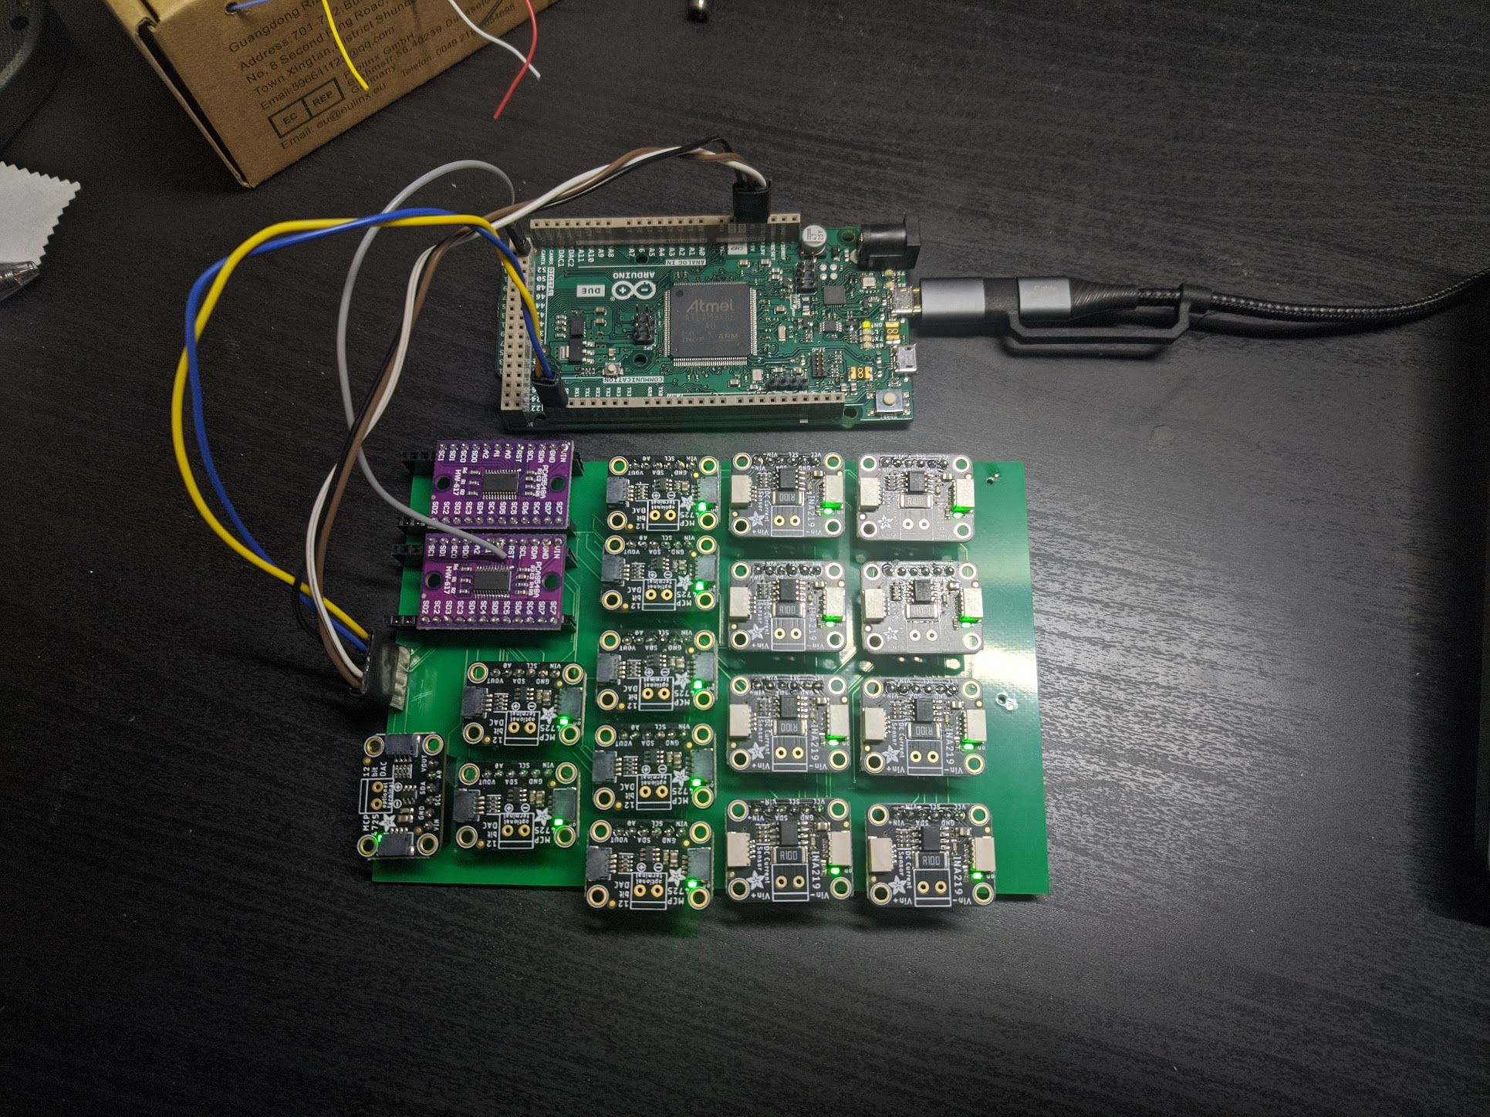
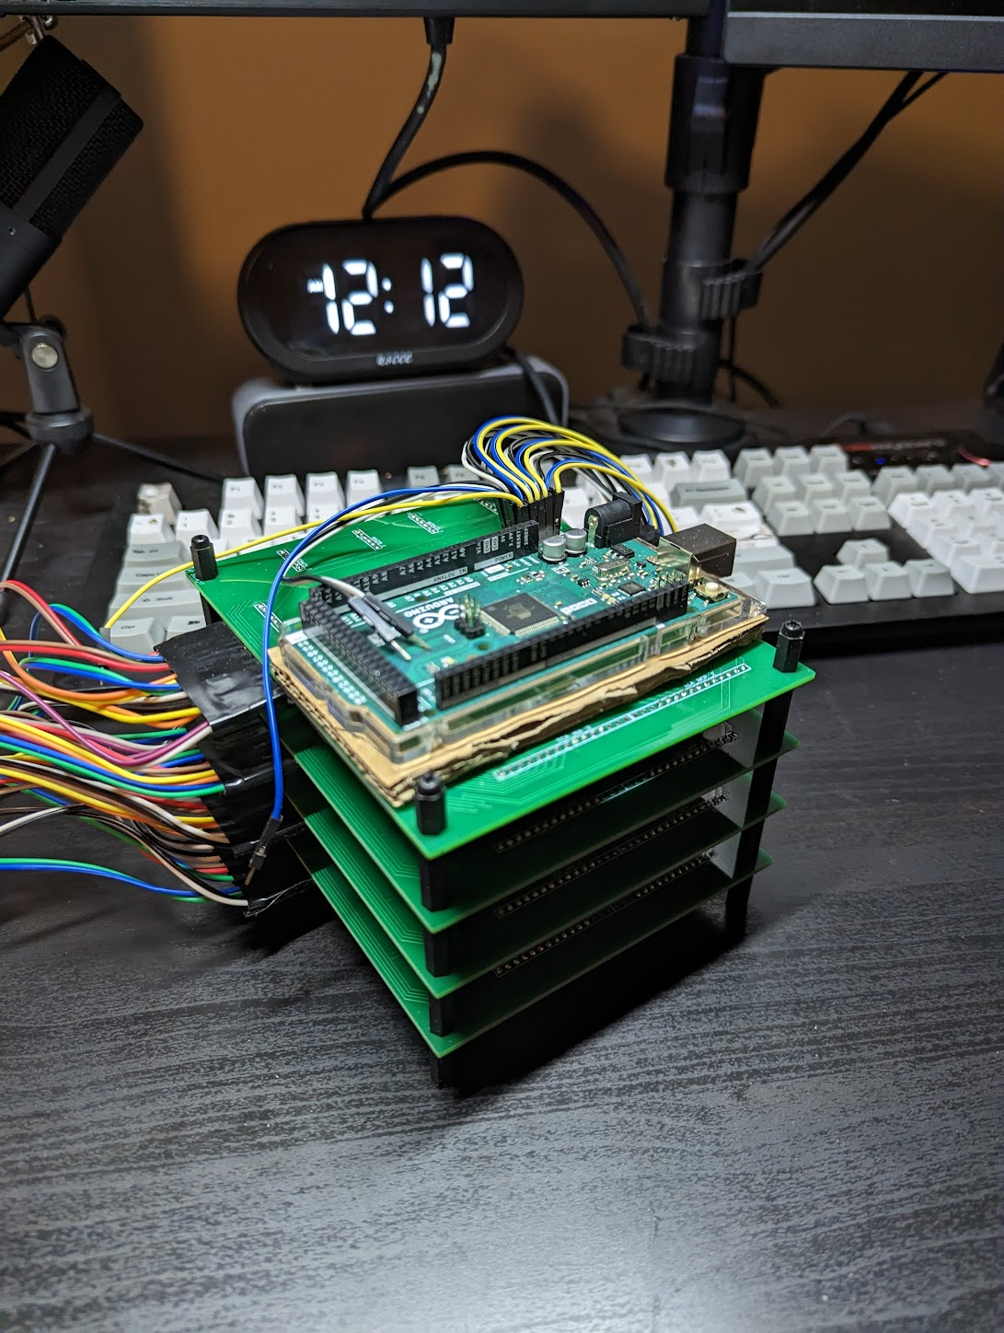
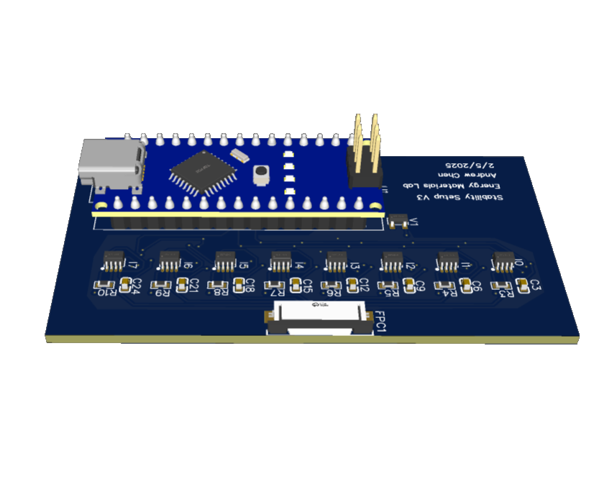
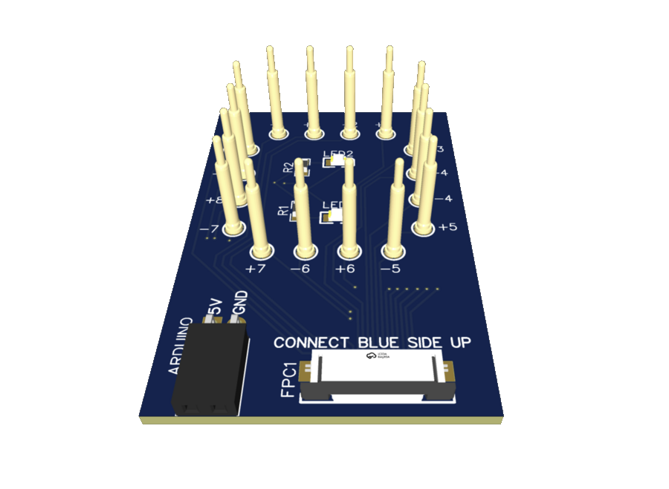
SMS Development History
Notes:
Chiral Perovskites​
Chirality is induced by adding chiral molecules in A-site​
Crystal orientation plays huge role in chirality of perovskites​
Poor photoluminescence quantum yield at room temperature​
RP Dimensionality​
Competition between 2D/quasi-2D/3D phase crystallization​
Effects bandgap, conductivity, energy funneling​
​
​

Slide 5
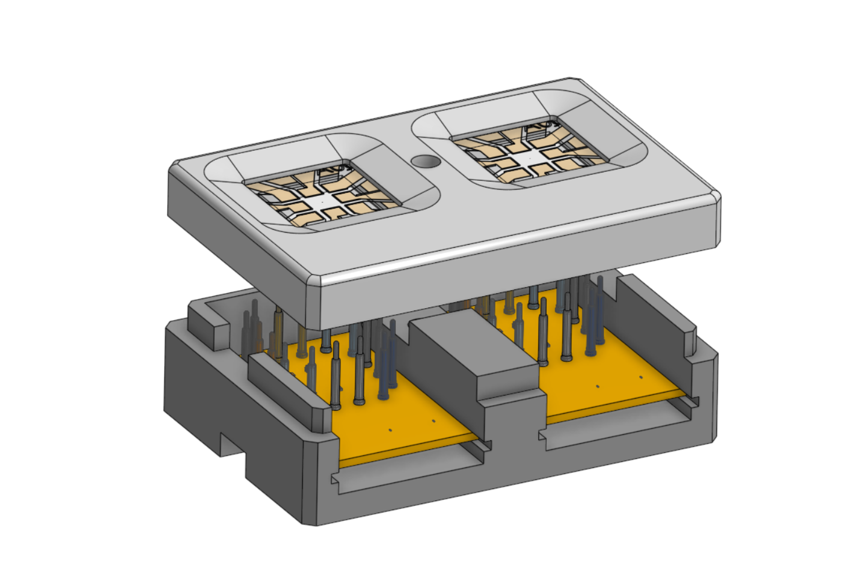
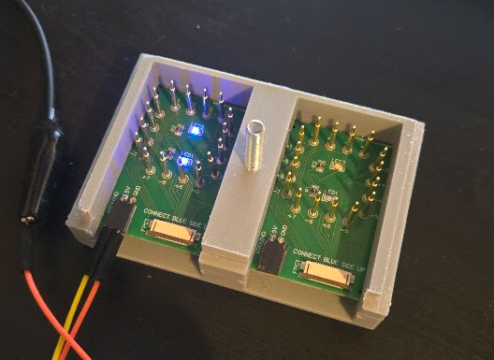
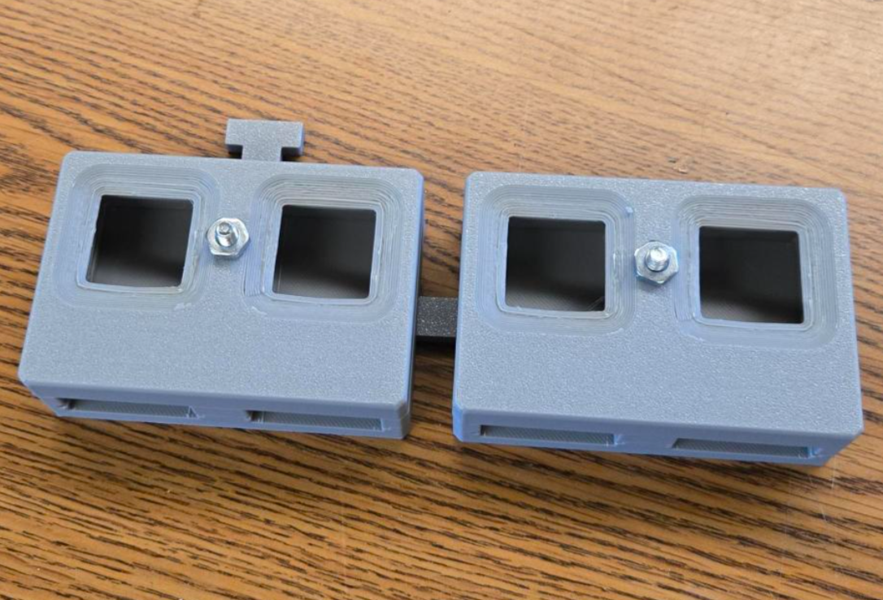
Hardware – SMS holder
<$40 per holder (2 devices)
N2 flow port
3d printed
Integrated LED for aligning mask
Modular
Drawbacks:
NO temperature control
NO temperature readings
NOT sealed
Requires silver paste on contacts for best results
Notes:
Chiral Perovskites​
Chirality is induced by adding chiral molecules in A-site​
Crystal orientation plays huge role in chirality of perovskites​
Poor photoluminescence quantum yield at room temperature​
RP Dimensionality​
Competition between 2D/quasi-2D/3D phase crystallization​
Effects bandgap, conductivity, energy funneling​
​
​

Slide 6
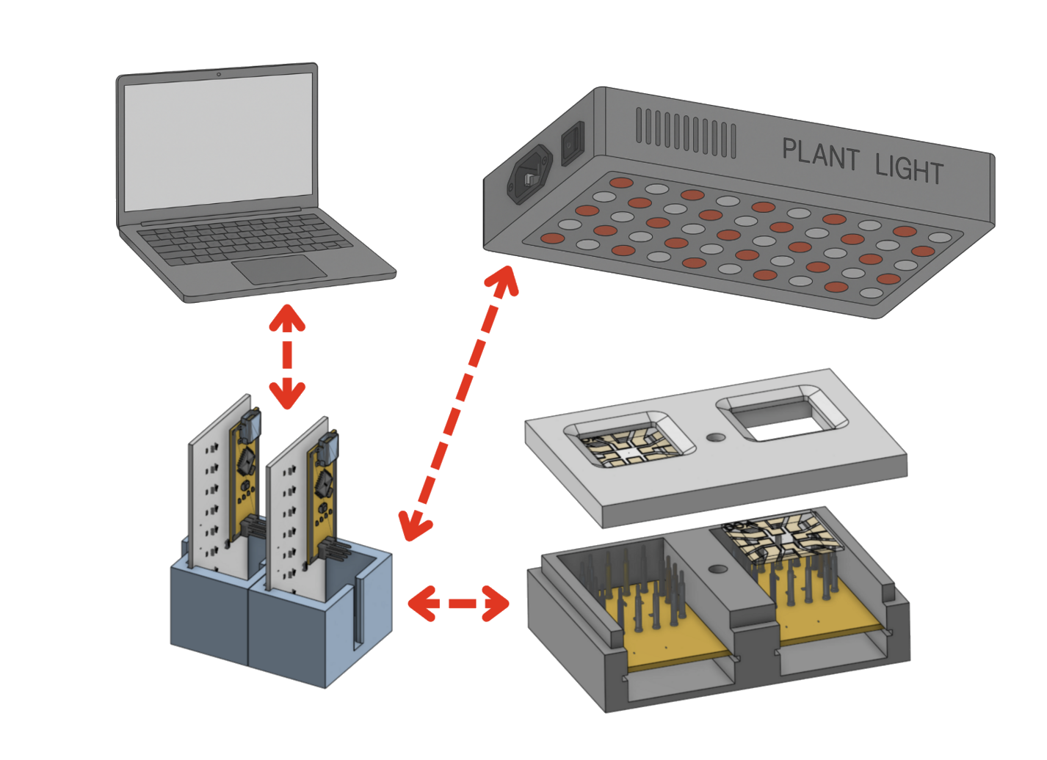
Hardware – SMS main board
Arduino Nano/ Nano equivalent
<$50 per board (1 device)
<$300 to measure 4 devices
~0.5% cost of Litos/Litos Lite
One computer can control over 32 devices
Notes:
Chiral Perovskites​
Chirality is induced by adding chiral molecules in A-site​
Crystal orientation plays huge role in chirality of perovskites​
Poor photoluminescence quantum yield at room temperature​
RP Dimensionality​
Competition between 2D/quasi-2D/3D phase crystallization​
Effects bandgap, conductivity, energy funneling​
​
​

Slide 7
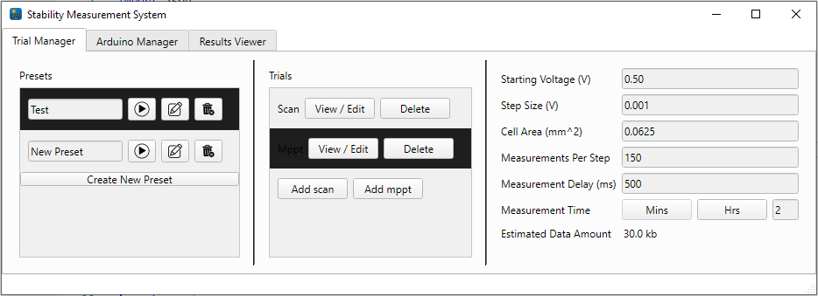
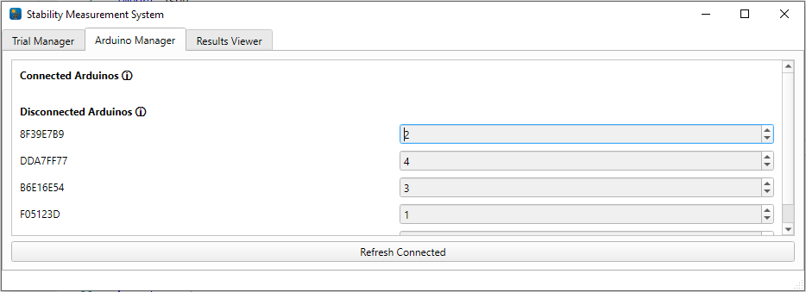
Software
Windows based python app
Easy to use
Easy to develop
Configurable testing
Automatic trial runs
Email notifications on trial status
Live data viewing
Notes:
Chiral Perovskites​
Chirality is induced by adding chiral molecules in A-site​
Crystal orientation plays huge role in chirality of perovskites​
Poor photoluminescence quantum yield at room temperature​
RP Dimensionality​
Competition between 2D/quasi-2D/3D phase crystallization​
Effects bandgap, conductivity, energy funneling​
​
​

Slide 8
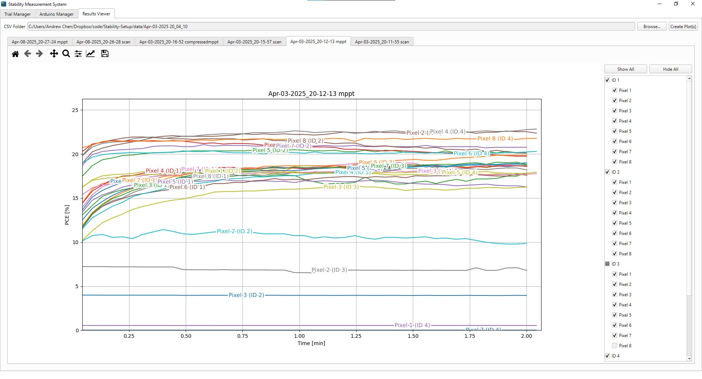
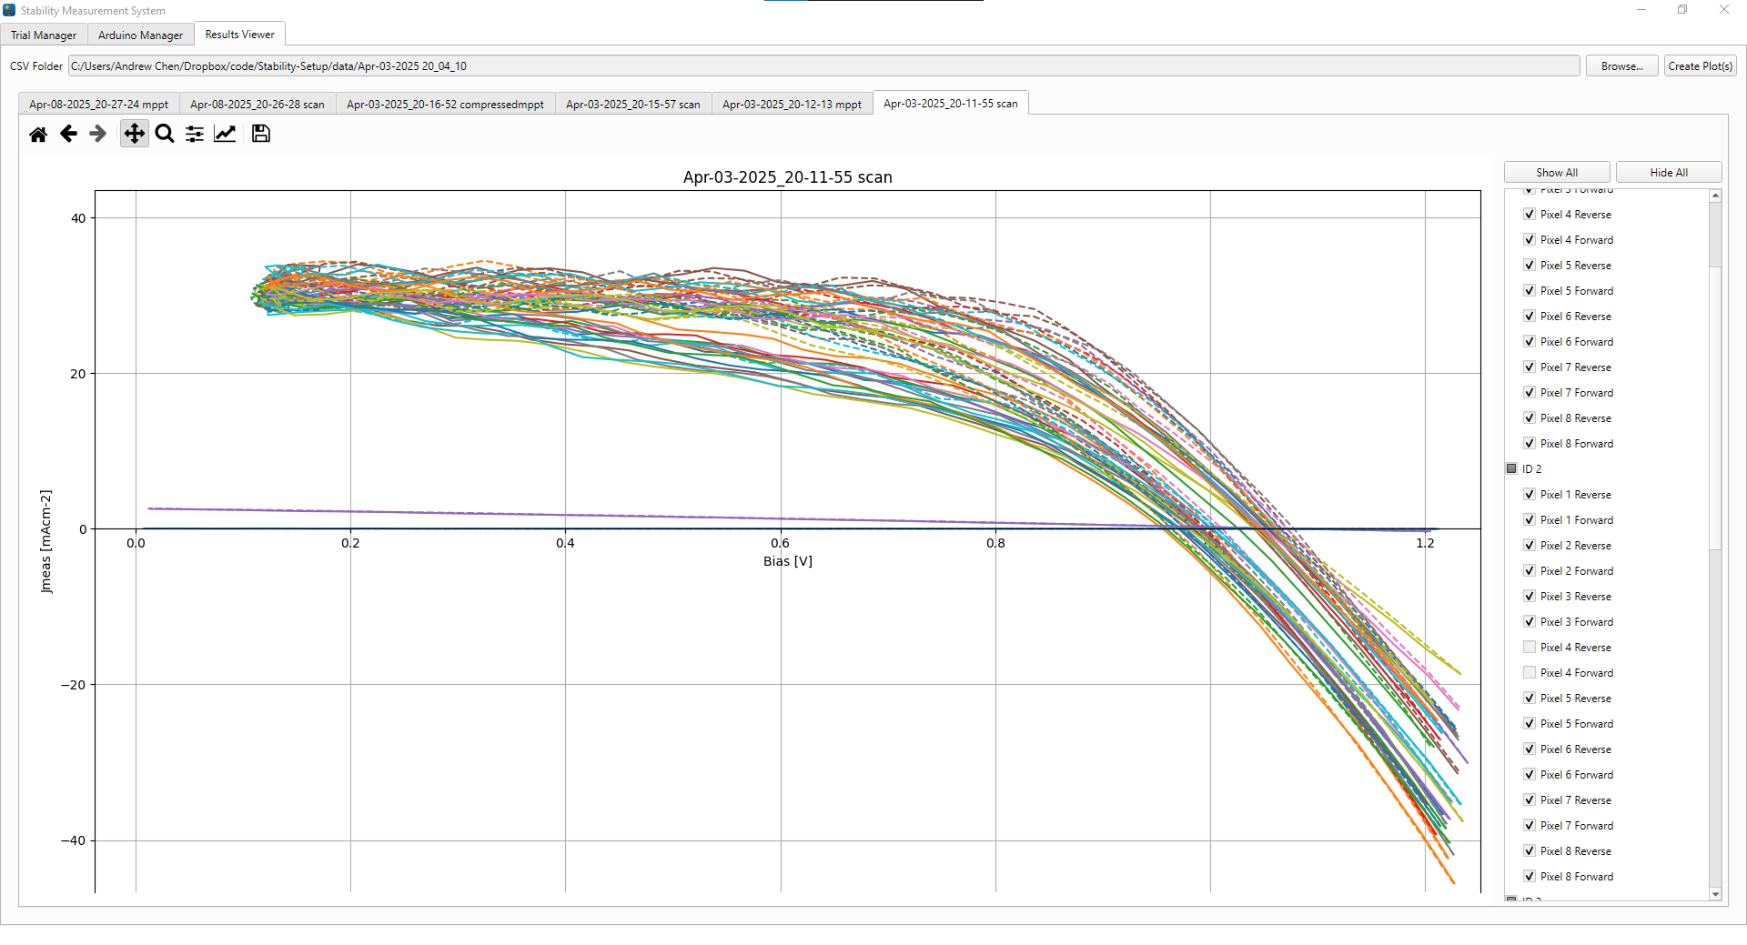
Software
Notes:
Chiral Perovskites​
Chirality is induced by adding chiral molecules in A-site​
Crystal orientation plays huge role in chirality of perovskites​
Poor photoluminescence quantum yield at room temperature​
RP Dimensionality​
Competition between 2D/quasi-2D/3D phase crystallization​
Effects bandgap, conductivity, energy funneling​
​
​

Slide 9
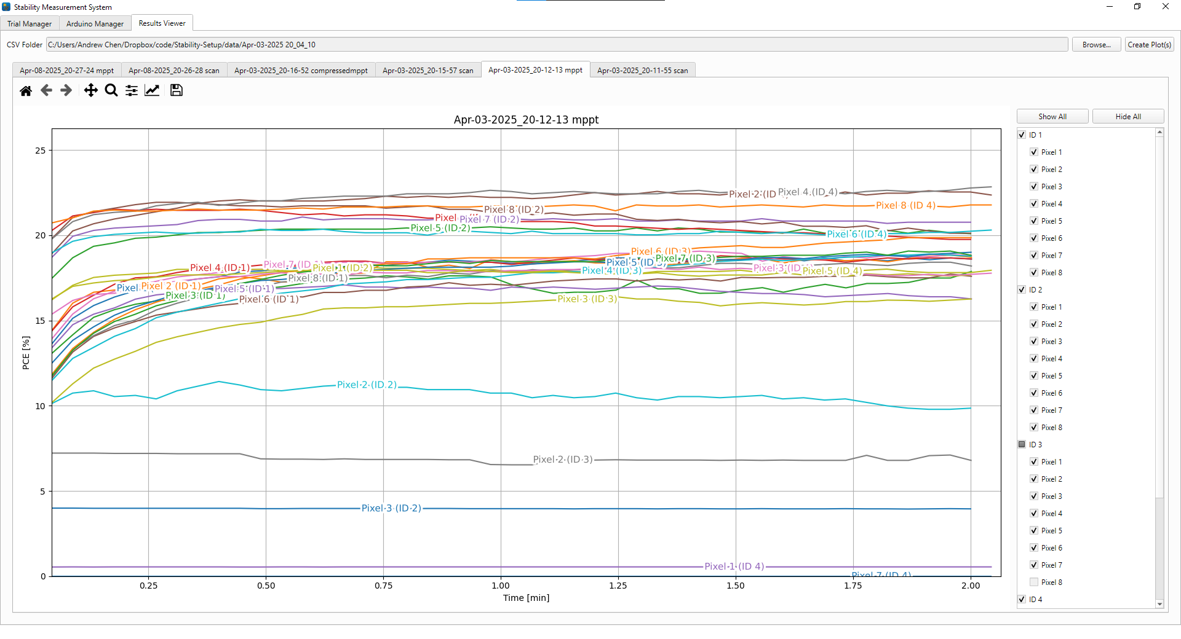
Software
Notes:
Chiral Perovskites​
Chirality is induced by adding chiral molecules in A-site​
Crystal orientation plays huge role in chirality of perovskites​
Poor photoluminescence quantum yield at room temperature​
RP Dimensionality​
Competition between 2D/quasi-2D/3D phase crystallization​
Effects bandgap, conductivity, energy funneling​
​
​

Slide 10
Experiment setup
Test same 4 devices on Litos Lite and SMS
WaveLabs lamp with AM1.5G illumination
JV Scan – Accuracy Test
0 - 1.2 V
Compare V_{OC} and V_{MPP} absolute difference
MPPT – Accuracy Test
2 minutes
Compare PCE absolute difference in last 2/3 of test
MPPT – Long Stability Measurement
200+ hr measurement
Test reliability of software/hardware
Notes:
Chiral Perovskites​
Chirality is induced by adding chiral molecules in A-site​
Crystal orientation plays huge role in chirality of perovskites​
Poor photoluminescence quantum yield at room temperature​
RP Dimensionality​
Competition between 2D/quasi-2D/3D phase crystallization​
Effects bandgap, conductivity, energy funneling​
​
​

Slide 11
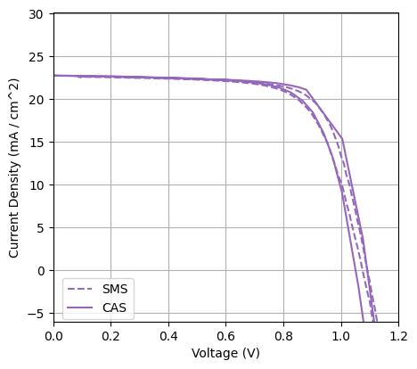
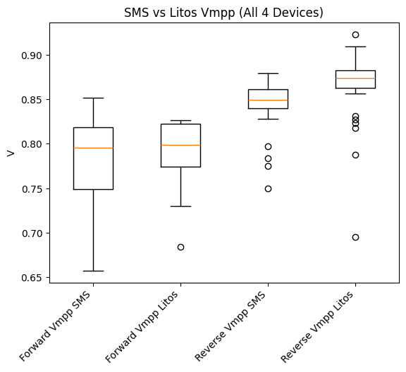
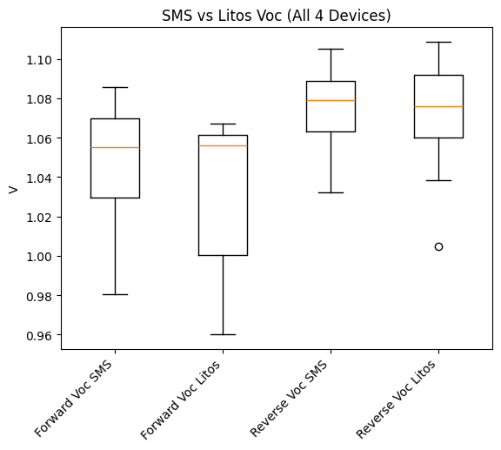
Experiment Results - jV Scan
Total Average Absolute VOC diff = 0.0170
Total Average Absolute VMPP diff = 0.0212
Notes:
Chiral Perovskites​
Chirality is induced by adding chiral molecules in A-site​
Crystal orientation plays huge role in chirality of perovskites​
Poor photoluminescence quantum yield at room temperature​
RP Dimensionality​
Competition between 2D/quasi-2D/3D phase crystallization​
Effects bandgap, conductivity, energy funneling​
​
​

Slide 12
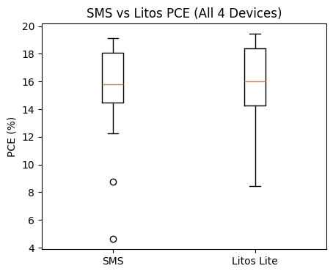
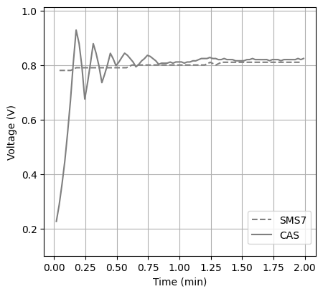
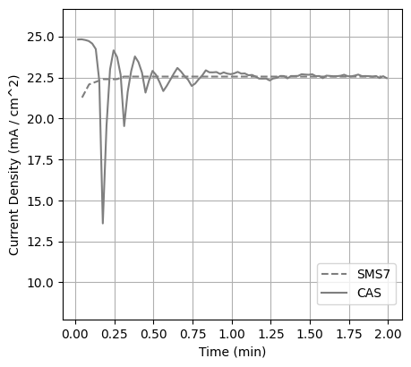
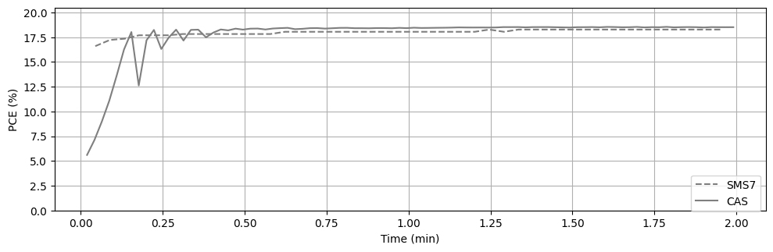
Experiment Results - Mppt
Best PCE % Absolute Difference= 0.038
Total Average PCE % Absolute Difference= 0.986
Notes:
Chiral Perovskites​
Chirality is induced by adding chiral molecules in A-site​
Crystal orientation plays huge role in chirality of perovskites​
Poor photoluminescence quantum yield at room temperature​
RP Dimensionality​
Competition between 2D/quasi-2D/3D phase crystallization​
Effects bandgap, conductivity, energy funneling​
​
​

Slide 13
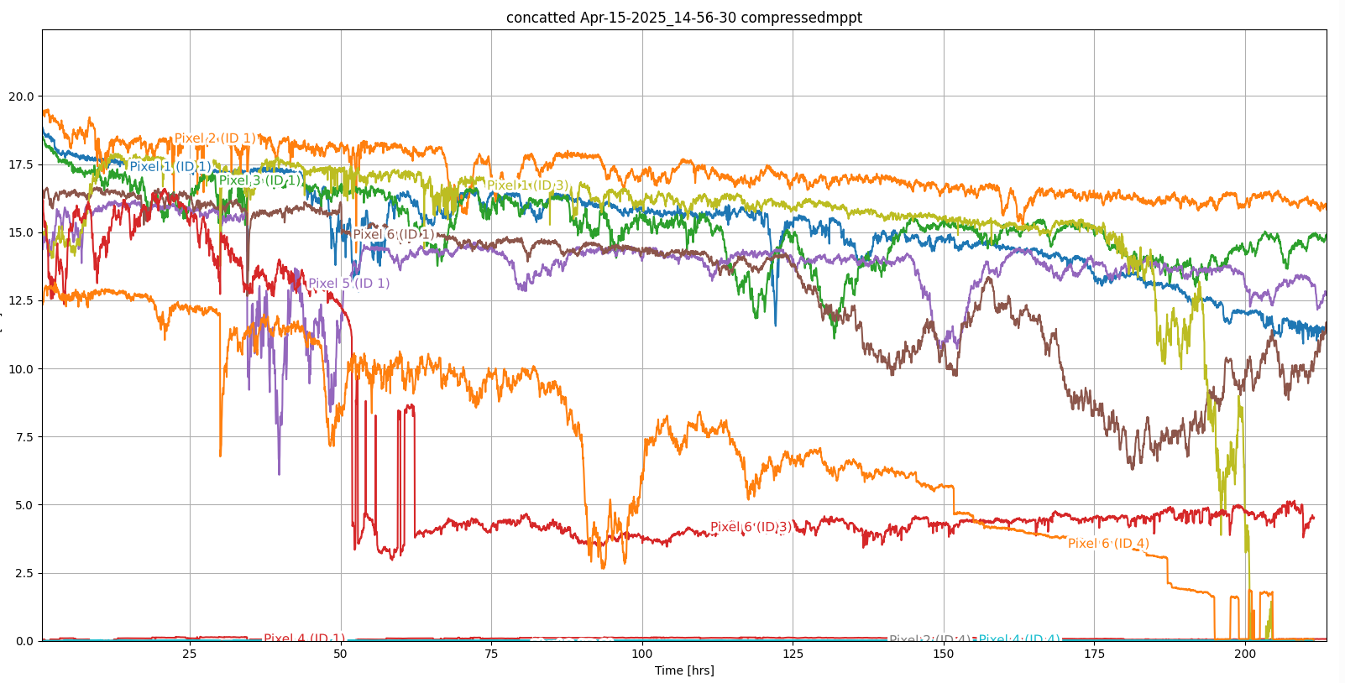
Experiment Results – Long term stability Measurement*
*Notes:
Tested 3 devices, some cells omitted from plot because of bad contact causing dropouts
This is 2 trials stitched together; first one stopped after 30 hours because of software bug
Notes:
Chiral Perovskites​
Chirality is induced by adding chiral molecules in A-site​
Crystal orientation plays huge role in chirality of perovskites​
Poor photoluminescence quantum yield at room temperature​
RP Dimensionality​
Competition between 2D/quasi-2D/3D phase crystallization​
Effects bandgap, conductivity, energy funneling​
​
​

Slide 14
Future works
Completed by me
Polish up software for lab use
Create Standard Operating Procedure Manual
Create code/software documentation
Create hardware documentation
Tasks others could take on
Creating environmental chamber
Paper exists for preexisting implementation
Creating more accurate solar simulator
Notes:
Chiral Perovskites​
Chirality is induced by adding chiral molecules in A-site​
Crystal orientation plays huge role in chirality of perovskites​
Poor photoluminescence quantum yield at room temperature​
RP Dimensionality​
Competition between 2D/quasi-2D/3D phase crystallization​
Effects bandgap, conductivity, energy funneling​
​
​

Slide 15
Special Thanks
Juan-Pablo Correa-Baena
Carlo Andrea Riccardo Perini
Sanggyun Kim
Ahmed Mohammed
Chudi Yue
Martin Gomez-Dominguez

